Slide 1

FastX - Bus Ticket Booking
TRAINER NAME:
Javeed Mohammed Husnuddin
TRAINEE NAME:
DIVYA SRI G

Slide 2
TECH-STACK
Frontend: Angular , TypeScript , Bootstrap , HTML , CSS
Backend: Spring Boot , Java , Spring Security , JWT Auth
Database: MySQL
API Style: RESTful (Spring MVC)
Tools & Testing: Postman , Docker , JUnit

Slide 3
About
FastX is an online bus ticket booking system that allows users to register, log in, book seats, make payments, and cancel bookings. It includes role-based access for Admin, Operators, and Users. The system is built with Spring Boot (backend), Angular (frontend), and uses JWT for authentication. It supports booking, seat management, payment processing, and cancellations.

Slide 4
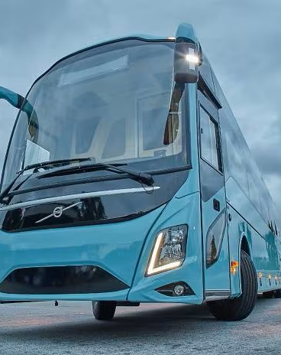
Modules:
User
Bus
Route
Seat
Booking
Payment
Cancellation (Microservice)

Slide 5
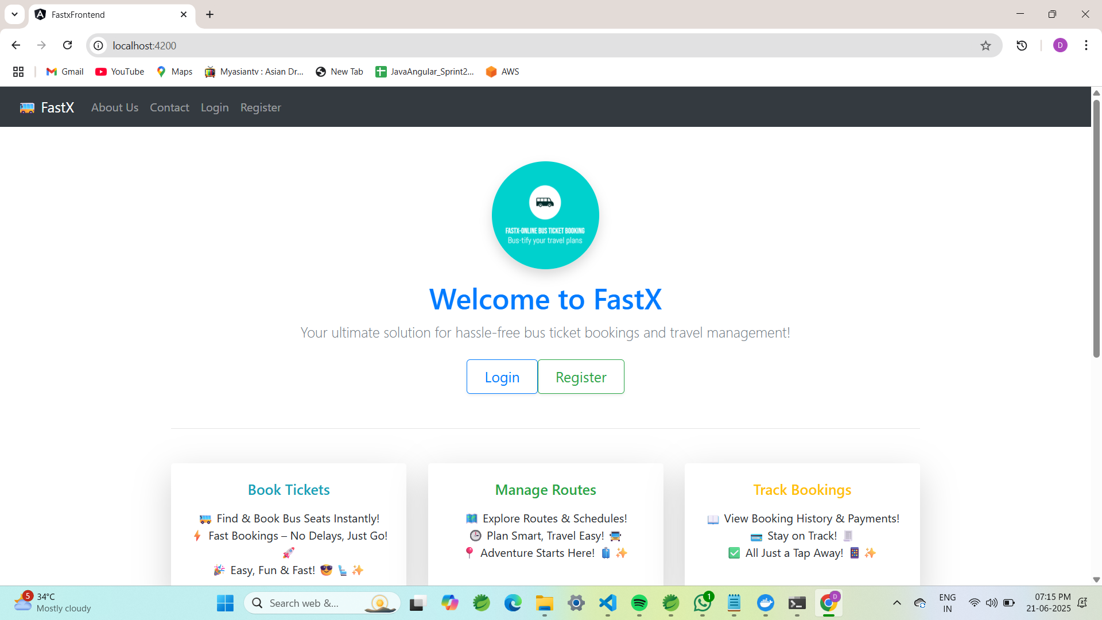

Slide 6
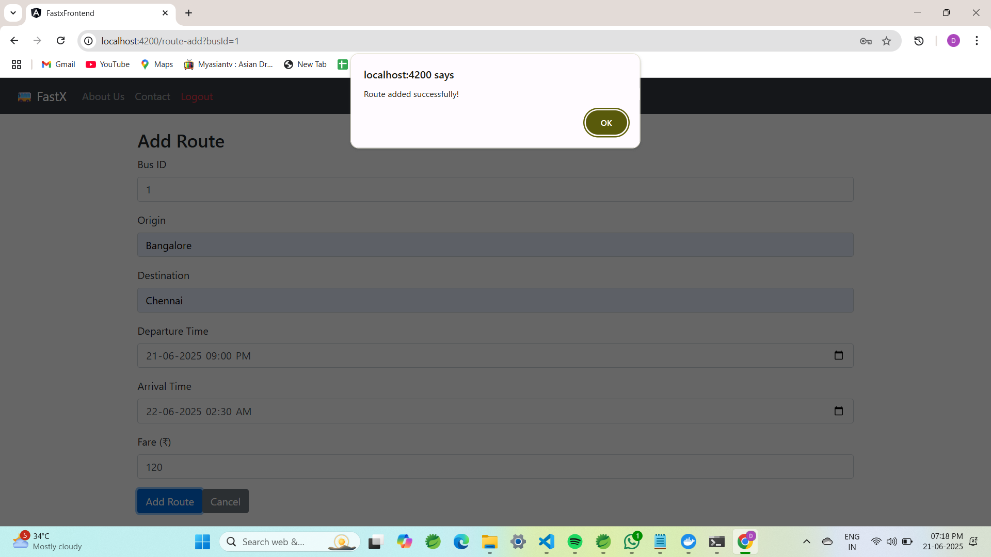
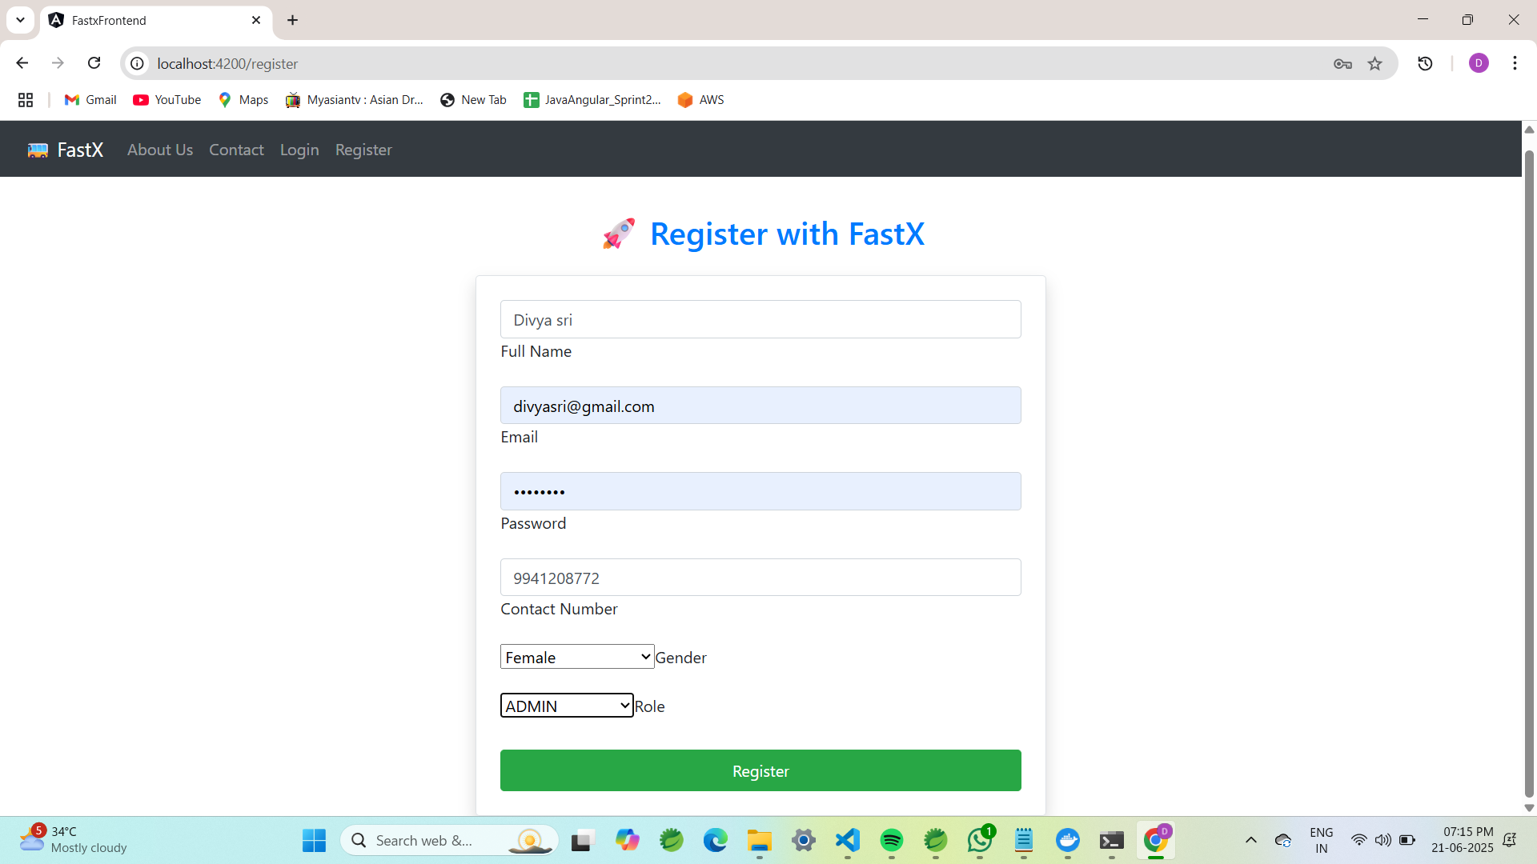

Slide 7
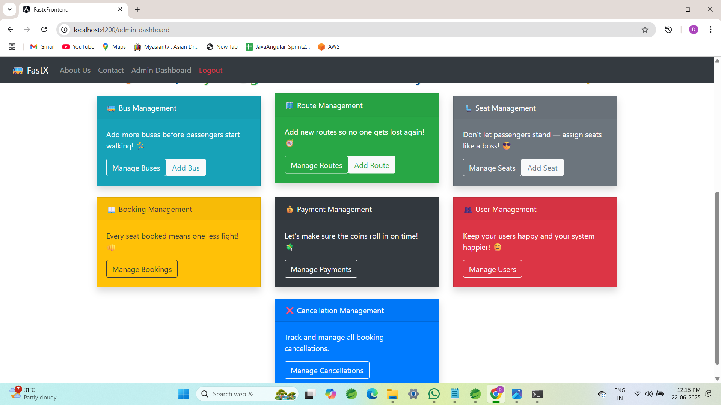

Slide 8
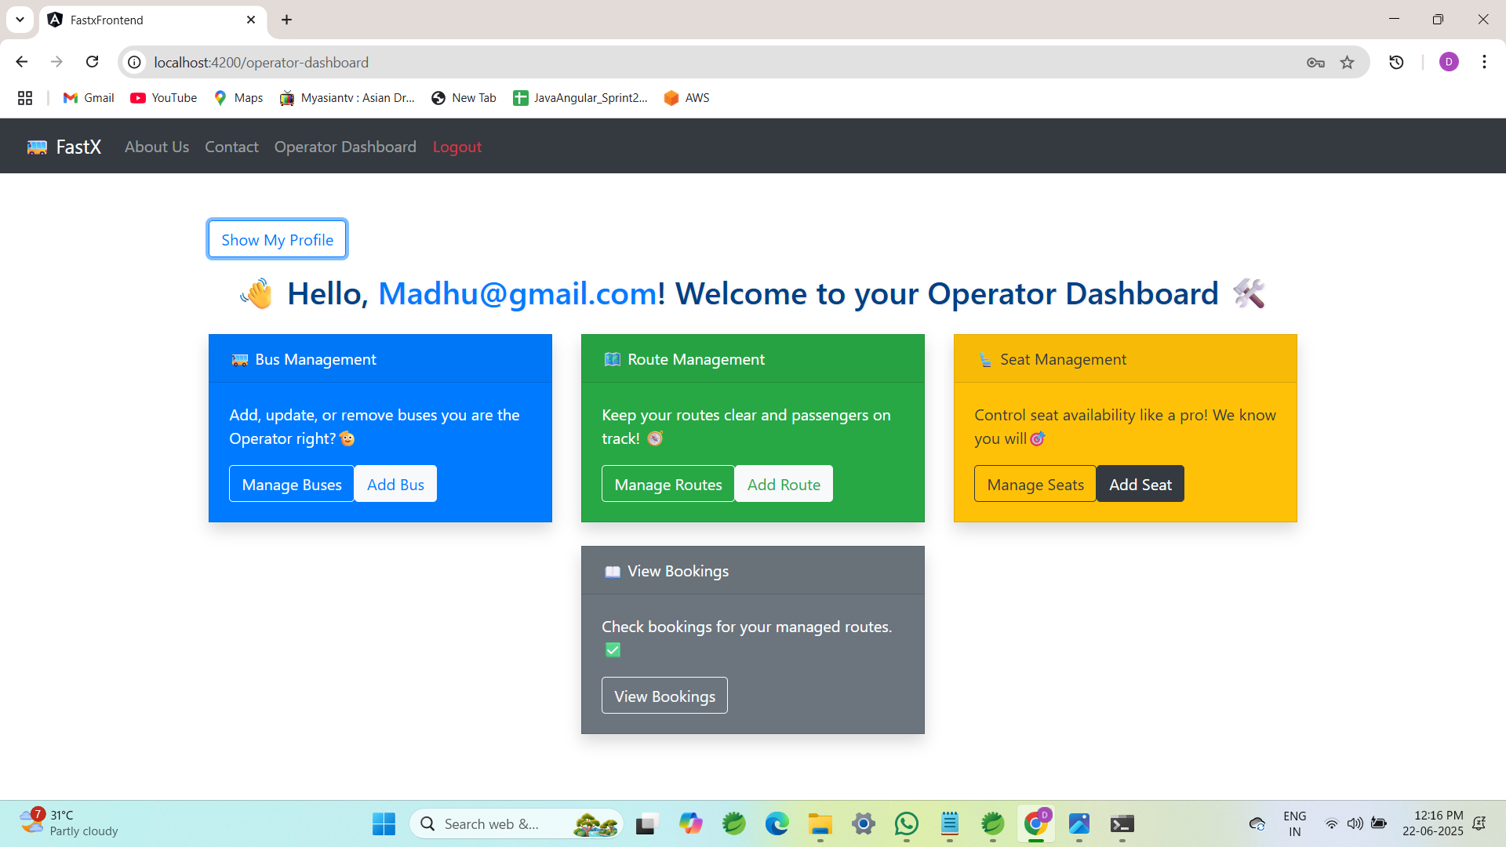

Slide 9
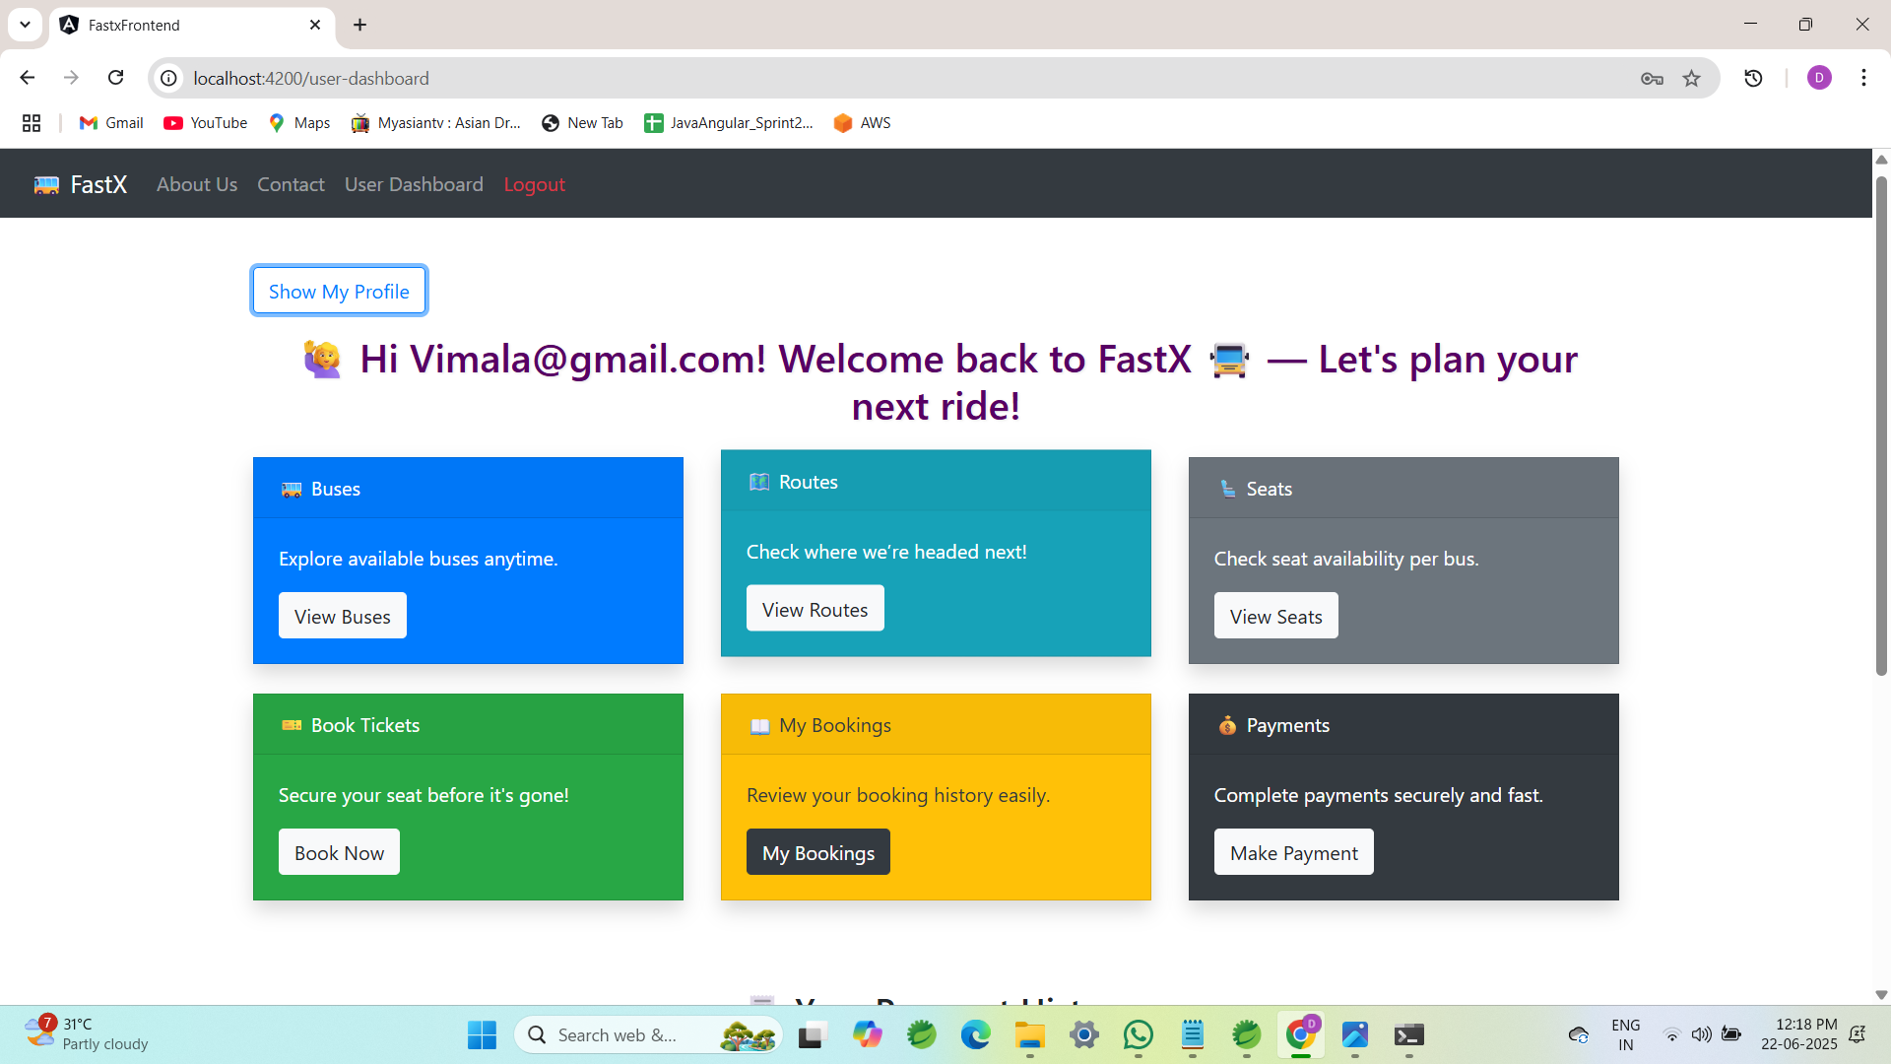

Slide 10
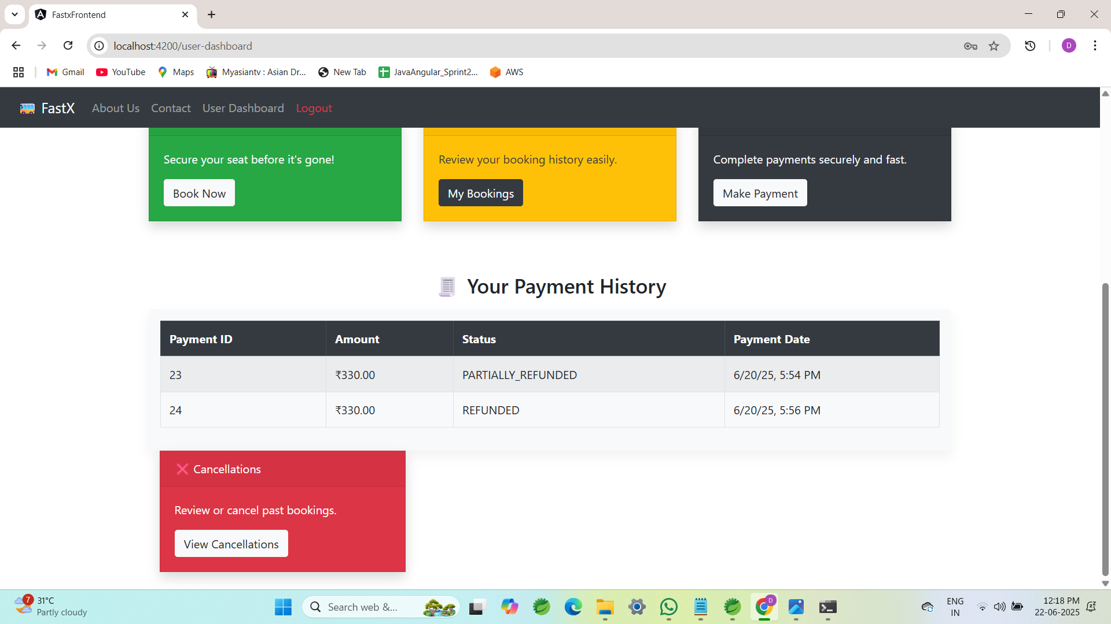

Slide 11
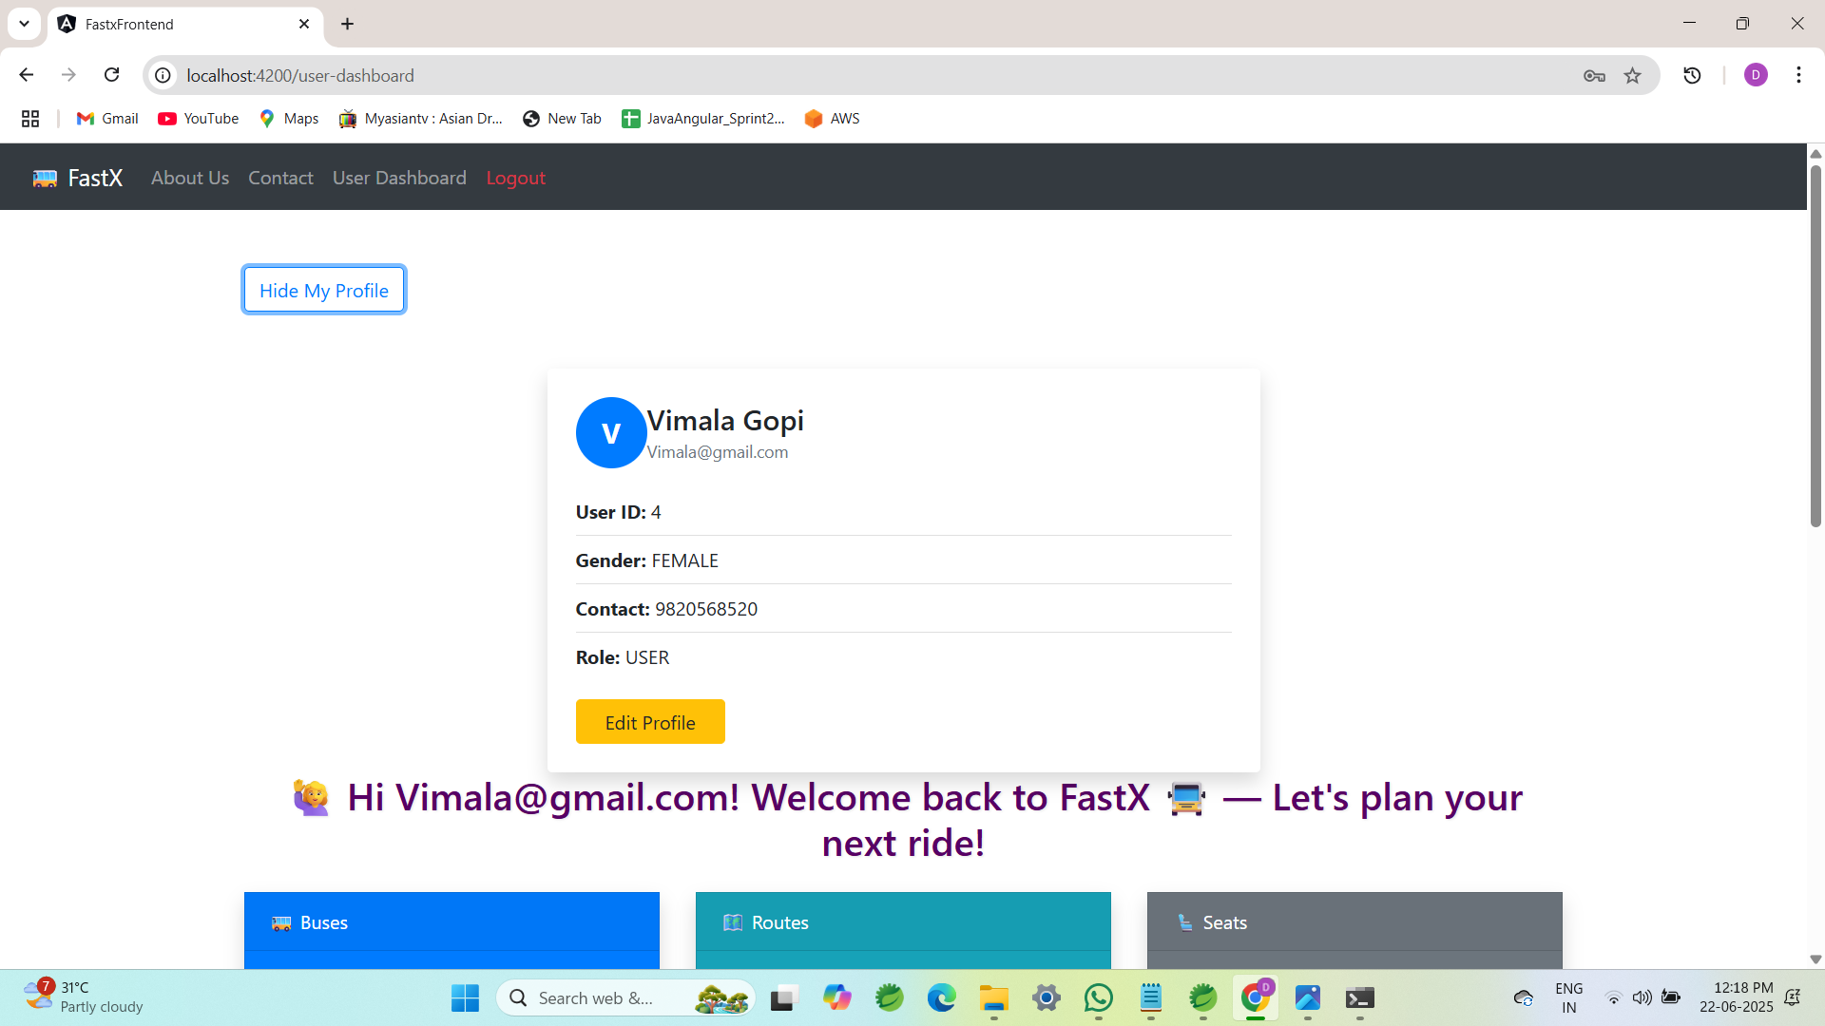

Slide 12
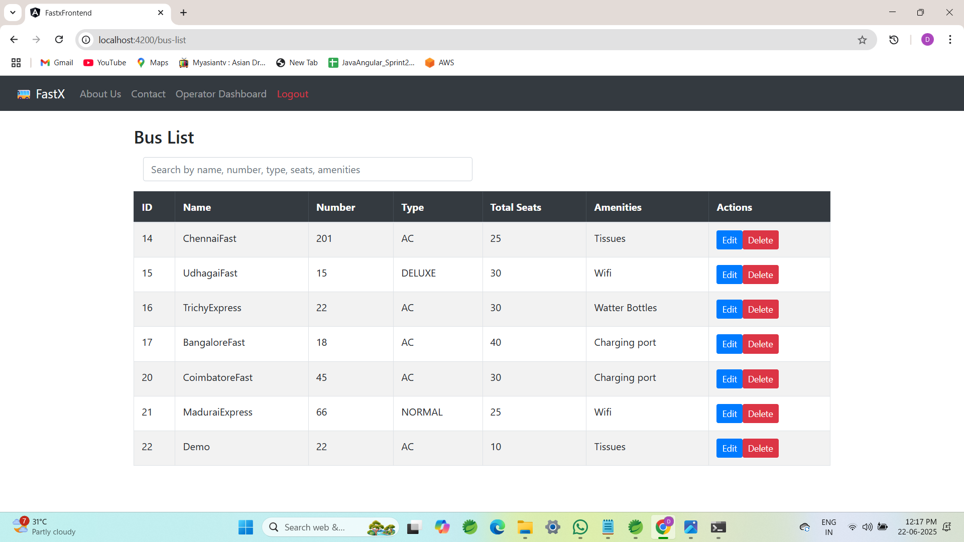

Slide 13
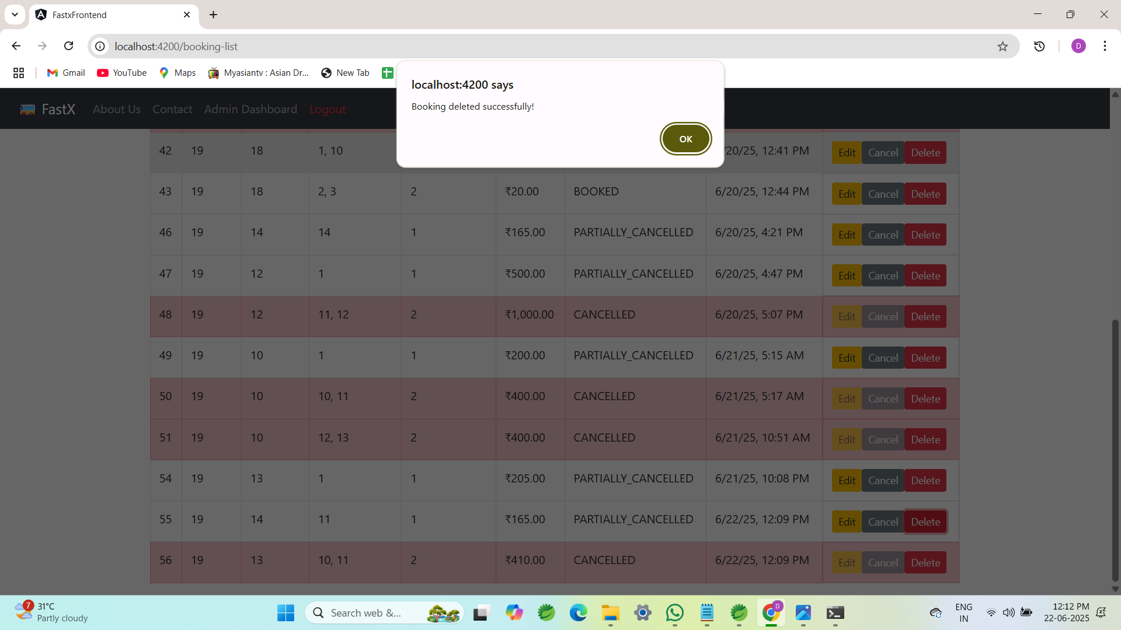
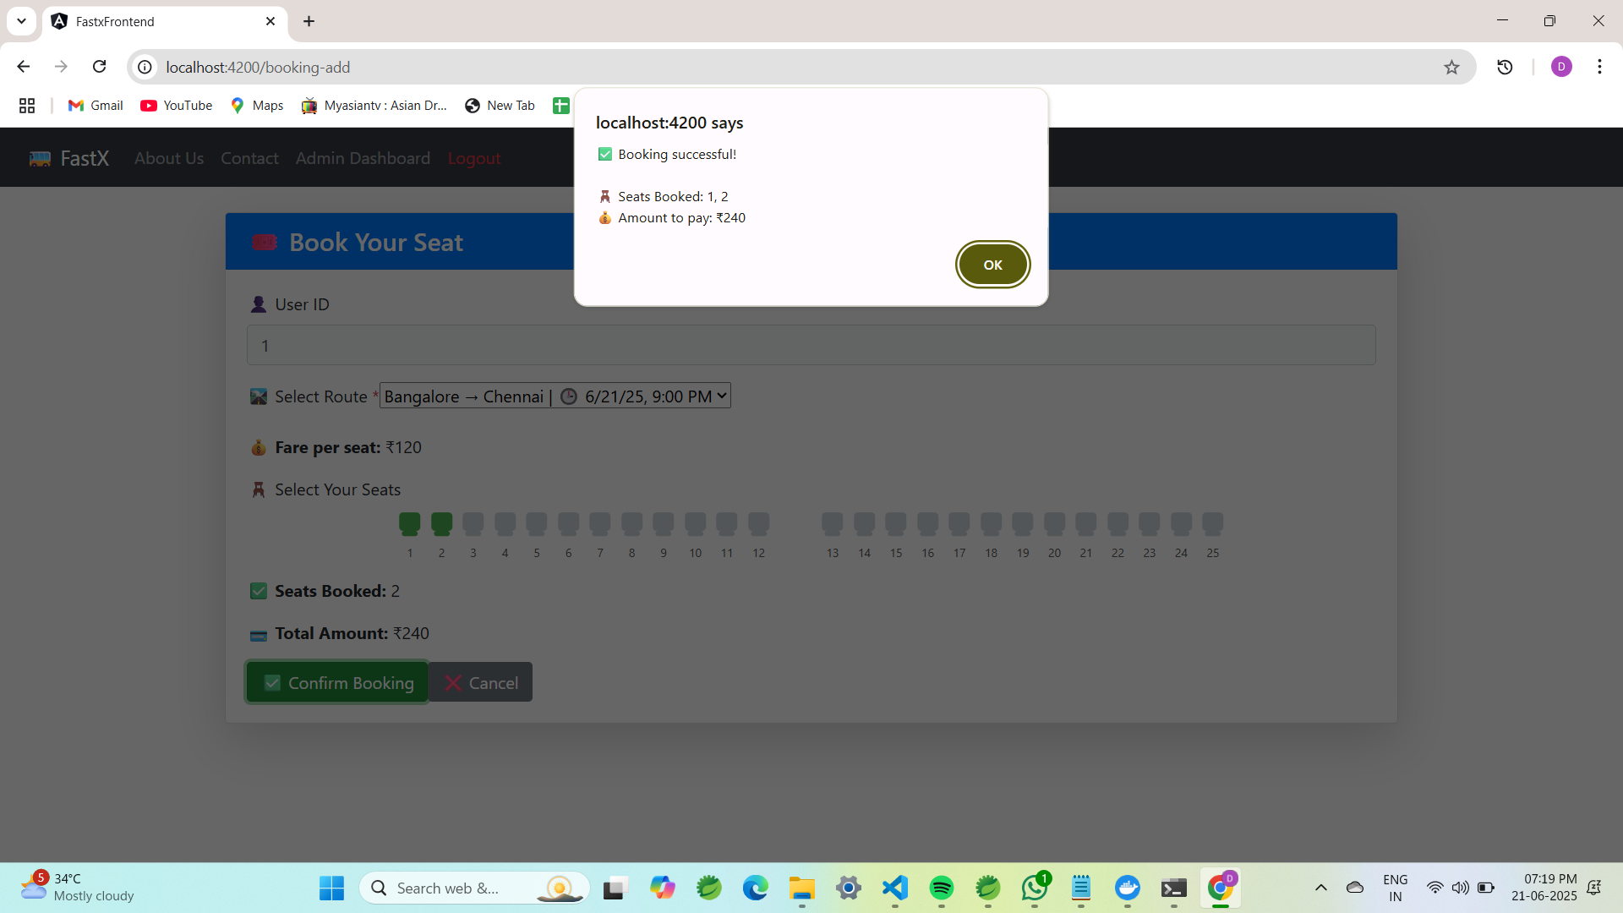

Slide 14
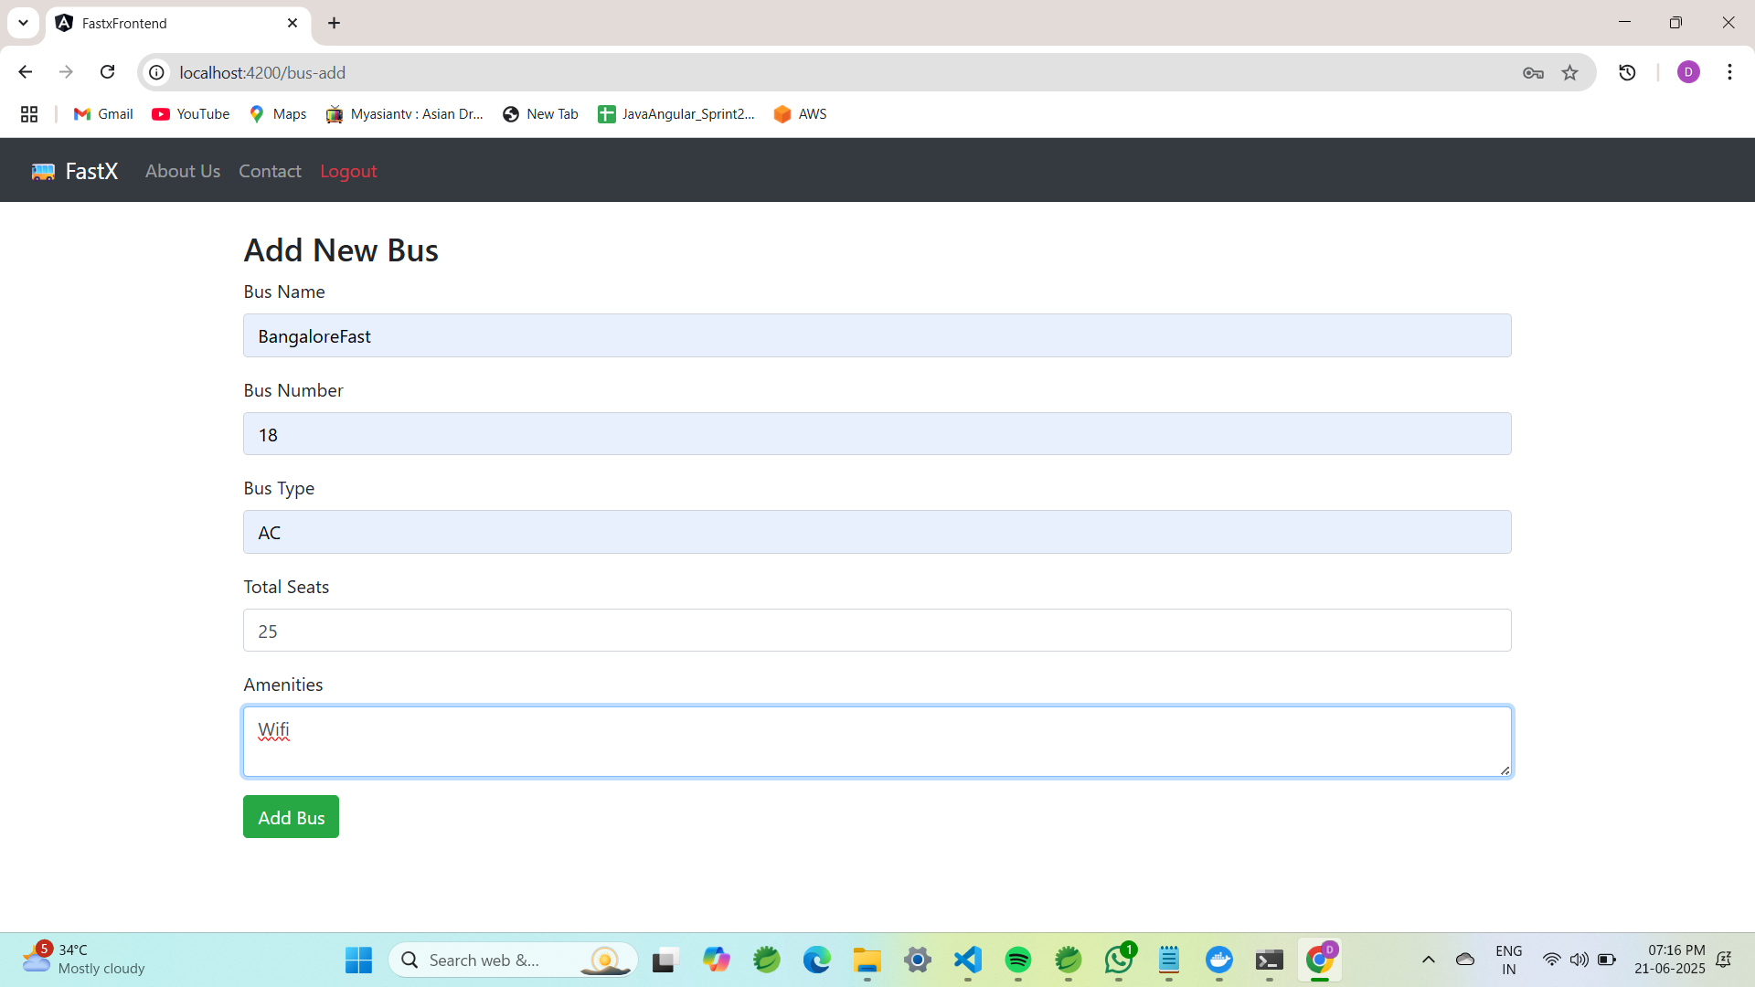
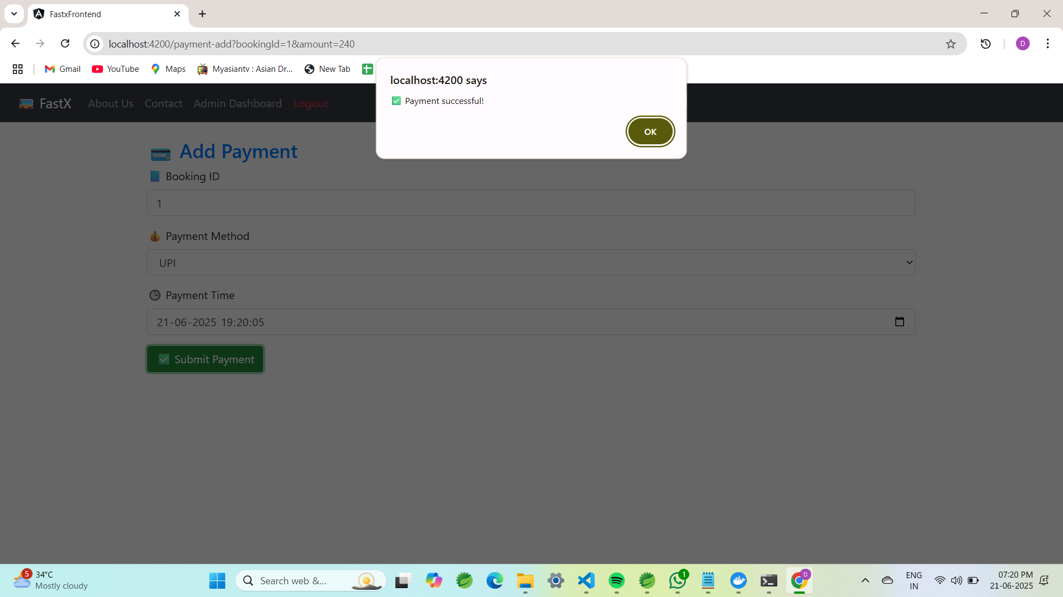

Slide 15
Thank you!!

